Slide 1

TEAM 7 SELLER MANAGEMENT SYSTEM
ASWIN/DARSHAN/SWARAJ/NARAYAN/ANUPAL

Slide 2
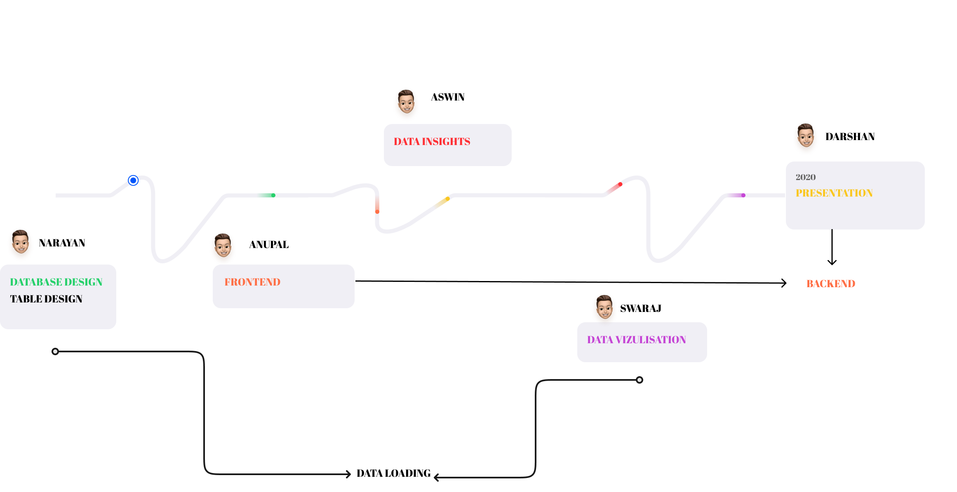
WORK FLOW

Slide 3

Problem Statement
Product Availability
Product Insights
Storage Management

Slide 4
Product Description
Our product focuses on the seller part which helps the seller to analyze their products selling percentage and other insights which are profitable to the seller.

Slide 5


Proposed System
LOG IN
SELLER ID
PASSWORD
PRODUCT LIST
PRODUCT NAME
SALES REPORT ANALYSIS

Slide 6
tools
PYTHON
TKINTER – USER INTERFACE
TABULATE
MYSQL
DATABASE

Slide 7
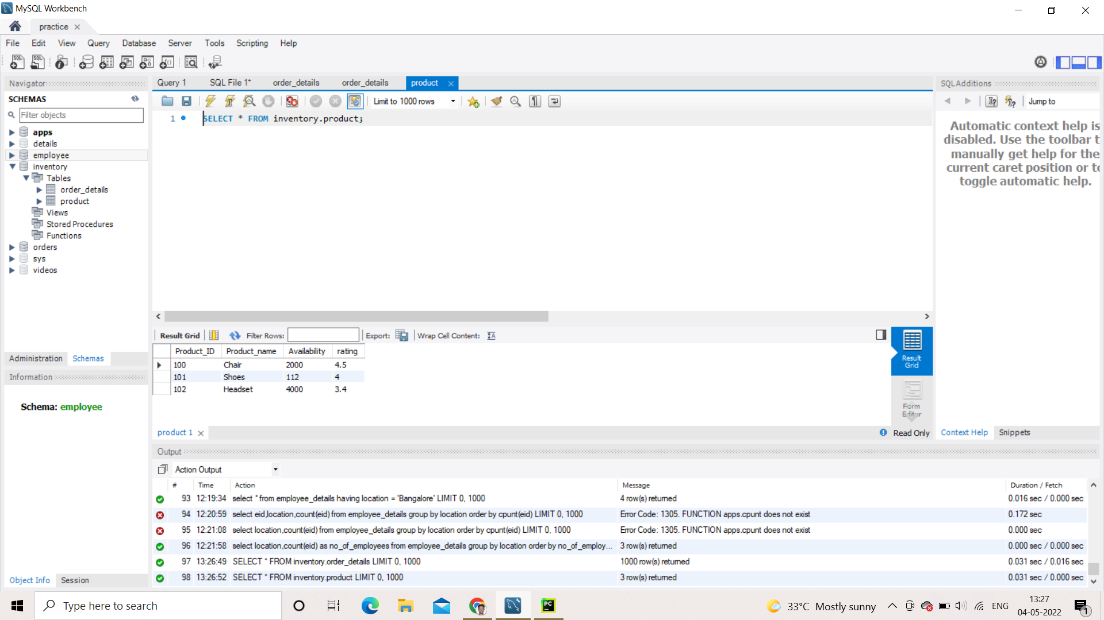
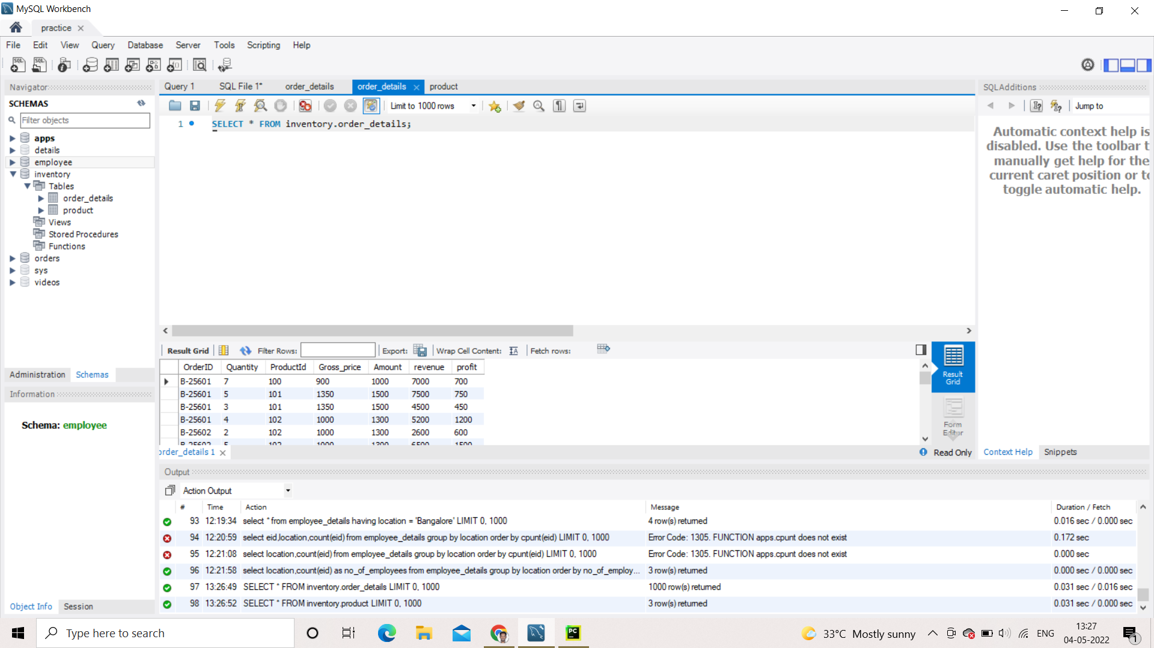
DATA DESCRIPTION
Product
Order details

Slide 8
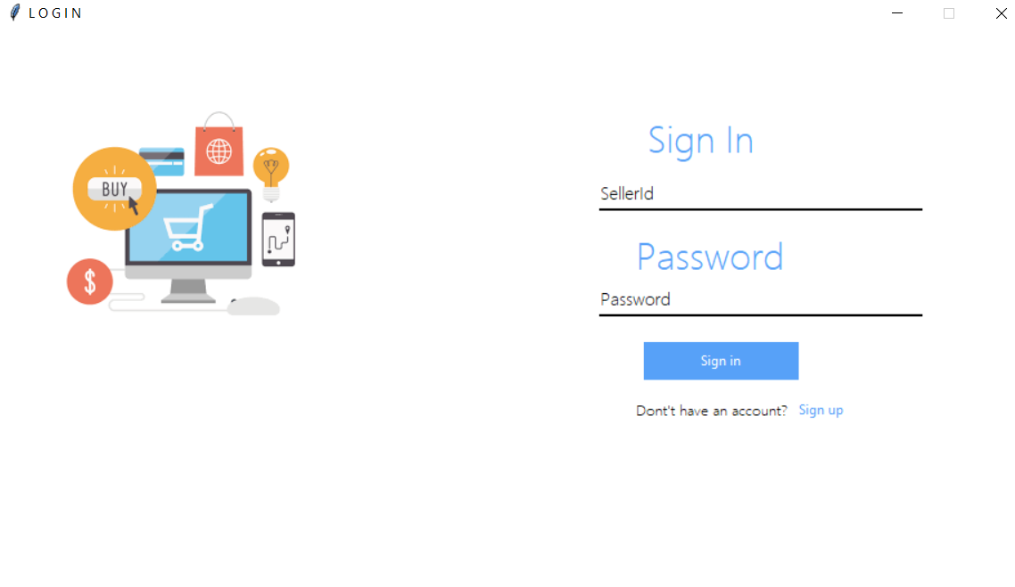
USER INTERFACE – PYTHON (TKINTER)

Slide 9
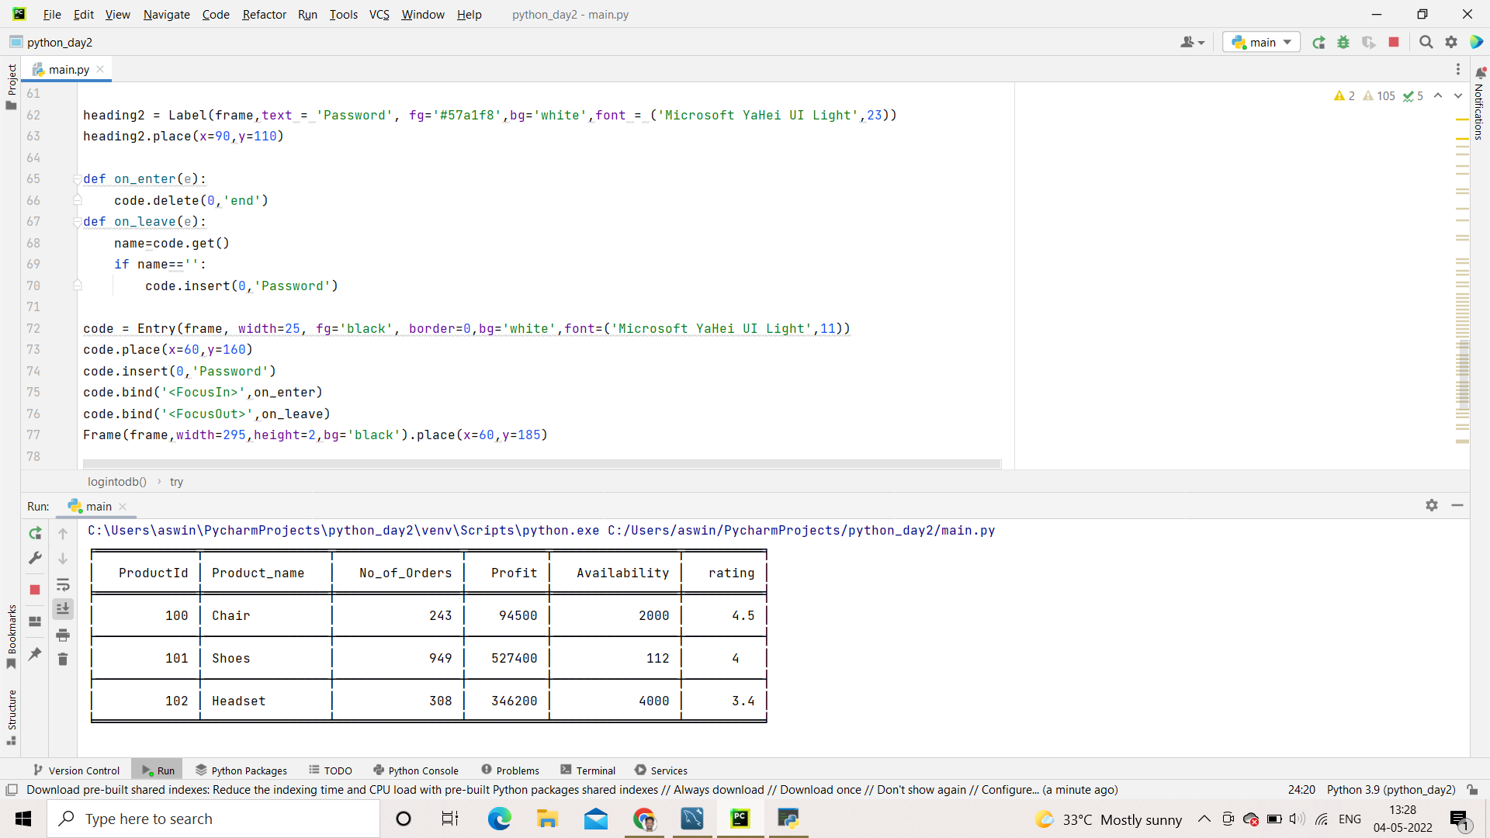
ANALSIS – (PRODUCT PERFORMANCE)

Slide 10
FURTHER DEVELOPMENT
EXTENDED TO MULTIPLE SELLER
GRAPHICAL REPRESENTATION
DETAILED ANALYSIS AND GENERATING SUGGESTION

